Slide 1
Living Fearless
Psalm 23

Slide 2
Summer Psalm: “Living Fearlessly”
What are you afraid of?

Slide 3
What are you afraid of?
“Pogonophobia”

Slide 4
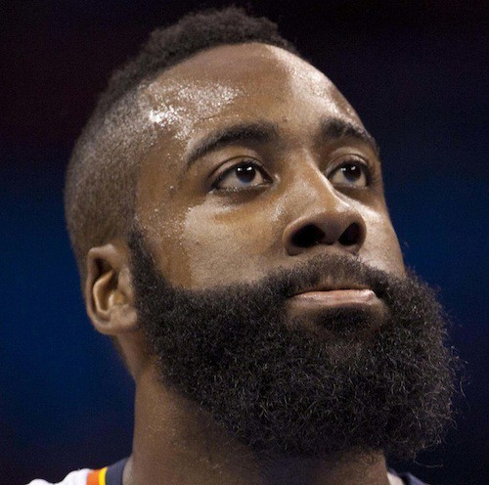
Pogonophobia
“The fear of beards”

Slide 5
What are you afraid of?
“Aerophobia”

Slide 6
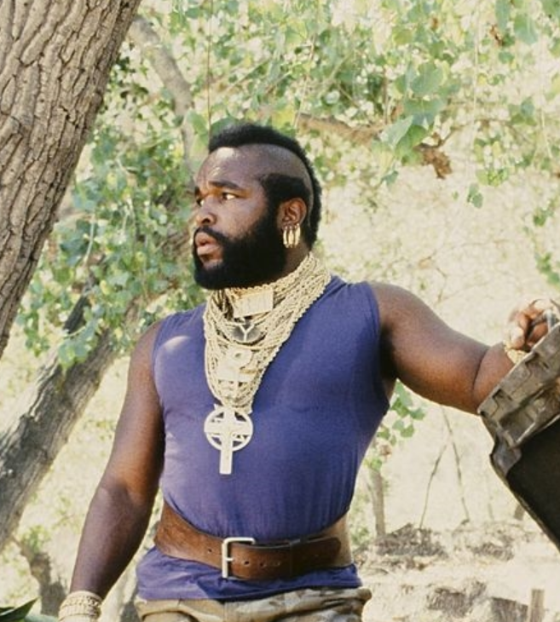
Aerophobia
“The fear of air travel”

Slide 7
What are you afraid of?
“Ailuraphobia”

Slide 8
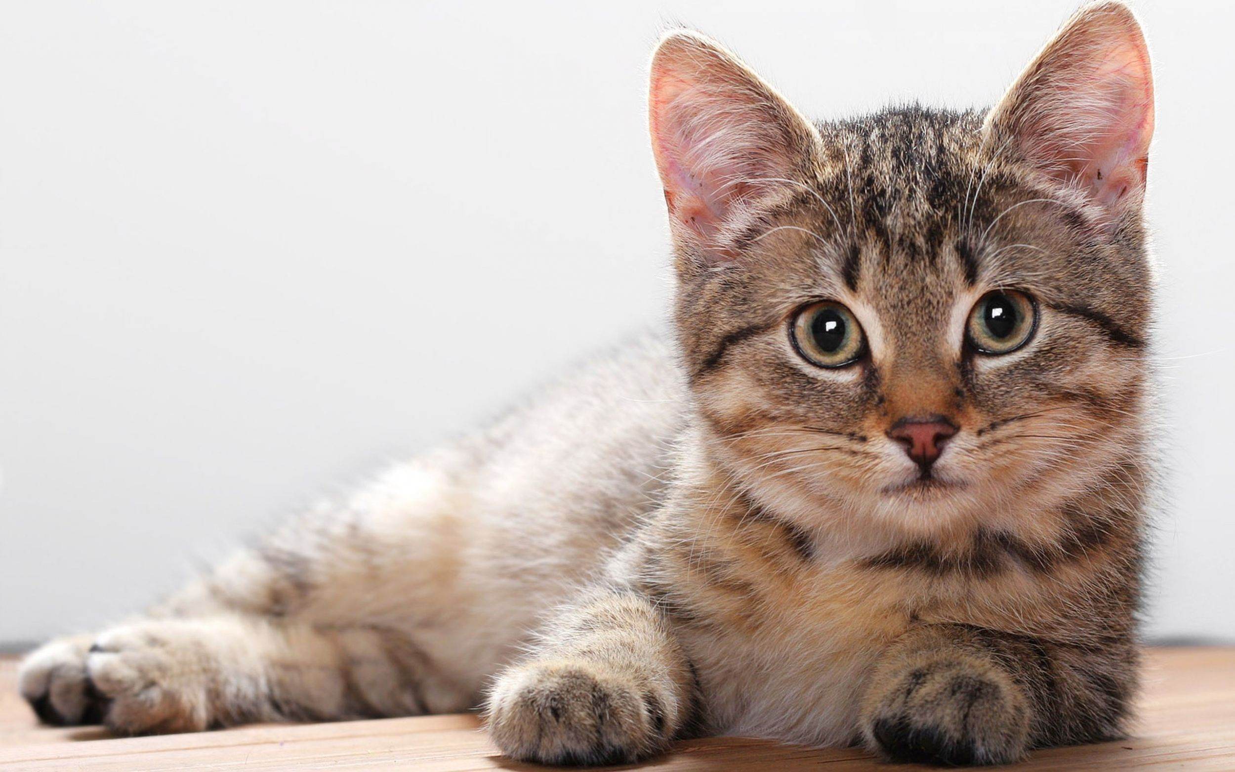
Ailuraphobia
“The fear of cats”

Slide 9
What are you afraid of?
“Sidonglobophobia”

Slide 10
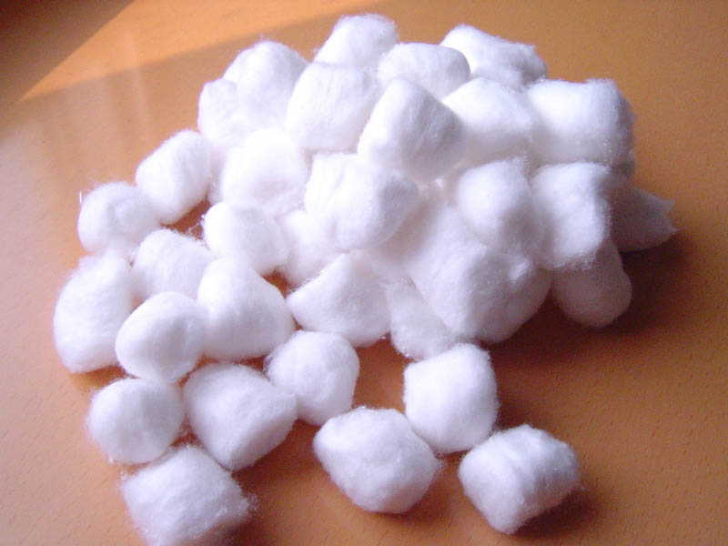
Sidonglobophobia
“The fear of cotton balls”

Slide 11
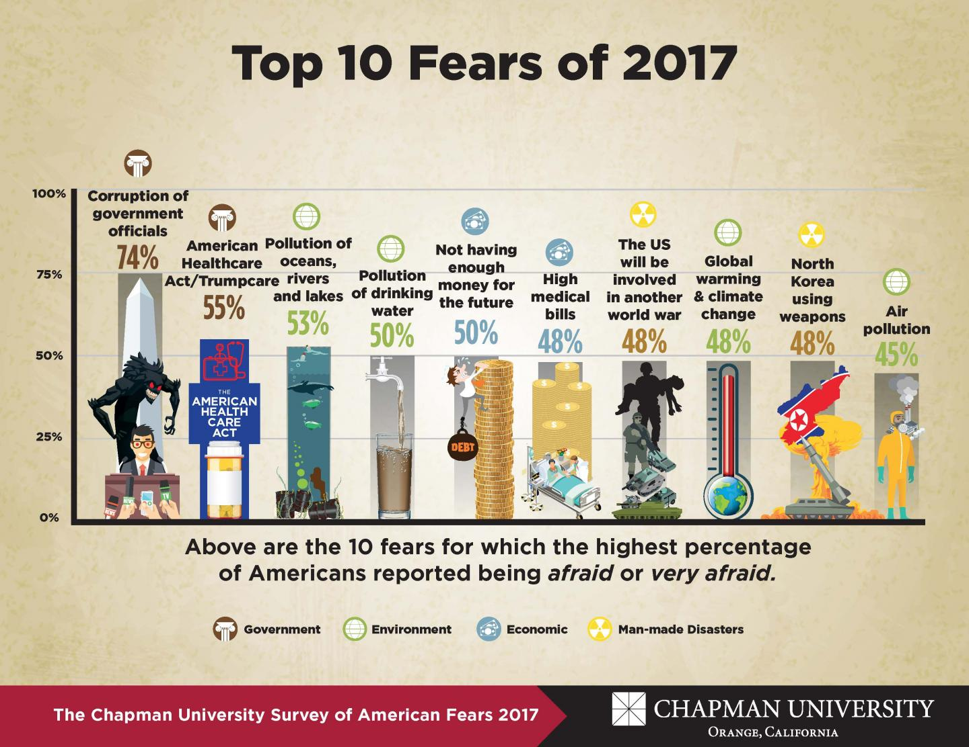
Fonts and Sizes
Please use Arial font for throughout the whole Power Point.
Headers should be set to 44pt.
Body should be set to 28pt.

Slide 12
Summer Psalm: “Living Fearlessly”
As Christians, we can live a life free of fear but only if we depend solely on God.

Slide 13
Summer Psalm: “Living Fearlessly”
Promise 1:
When we depend solely on God, we can take comfort in the promise of His spiritual provision.

Slide 14
Summer Psalm: “Living Fearlessly”
“My son, do not despise the chastening of the LORD, Nor be discouraged when you are rebuked by Him; For whom the LORD loves He chastens, And scourges every son whom He receives...Now no chastening seems to be joyful for the present, but painful; nevertheless, afterward it yields the peaceable fruit of righteousness to those who have been trained by it.” Hebrews 12:5-6, 10

Slide 15
Summer Psalm: “Living Fearlessly”
Promise 2:
When we depend solely on God, we can take comfort in the promise of His presence.

Slide 16
Summer Psalm: “Living Fearlessly”
“But now, thus says the LORD, who created you, O Jacob, And He who formed you, O Israel: Fear not, for I have redeemed you; I have called you by your name; You are Mine. When you pass through the waters, I will be with you; And through the rivers, they shall not overflow you. When you walk through the fire, you shall not be burned, Nor shall the flame scorch you”. Isaiah 43:2

Slide 17
Summer Psalm: “Living Fearlessly”
“Blessed be the God and Father of our Lord Jesus Christ, the Father of mercies and God of all comfort, who comforts us in all our tribulation, that we may be able to comfort those who are in any trouble, with the comfort with which we ourselves are comforted by God.” I Corinthians 1:1-3

Slide 18
Summer Psalm: “Living Fearlessly”
Promise 3:
When we depend solely on God, we can take comfort in the promise of His permanent peace.

Slide 19
Summer Psalm: “Living Fearlessly”
“My sheep hear My voice, and I know them, and they follow Me. And I give them eternal life, and they shall never perish; neither shall anyone snatch them out of My hand.” John 10:27-28

Slide 20
Summer Psalm: “Living Fearlessly”
“Blessed be the God and Father of our Lord Jesus Christ, who according to His abundant mercy has begotten us again to a living hope through the resurrection of Jesus Christ from the dead, to an inheritance incorruptible and undefiled and that does not fade away, reserved in heaven for you, who are kept by the power of God through faith for salvation ready to be revealed in the last time.” I Peter 1:3-5

Slide 21
Summer Psalm: “Living Fearlessly”
As Christians, we can live a life free of fear but only if we depend solely on God.

Slide 22
Top Fears Among Parents
30% of respondents fear their child will be hurt in an accident.
25% of respondents fear someone will hurt or attack their child.
23% of respondents fear their children won’t feel safe in the world.
14% of respondents fear their kids will be kidnapped or abducted.
8% of respondents fear their kids will be bullied.

Slide 23
Top Fears Among Kids
Infants and Toddlers – Loud Noises, Separation, Clowns
Preschoolers – Loud Noises, Change, Clowns
5-6 Old – Separation, the Dark, Ghosts, Bad Dreams
7-11 – Ghosts, Being Alone, Rejection, Bad Things
Adolescents – Not Being Accepted, Performance, Death

Slide 24
Borders
Do not allow text to close to the borders of your Power Point.
If possible keep all text an equal distance from each boarder of the Power Point.

Slide 25
Location of Text
Please make sure your header and body is in the same location each time.
For example please look at the next slide.

Slide 26
Location of Text
Notice the header is higher and moved to right compared to the previous slide.
To avoid this please duplicate the first slide then place the new content in the new slide.

Slide 27
Backgrounds and Colors
Please use white text on this background.

Slide 28
Backgrounds and Colors
Please use white text on this background.

