Slide 1
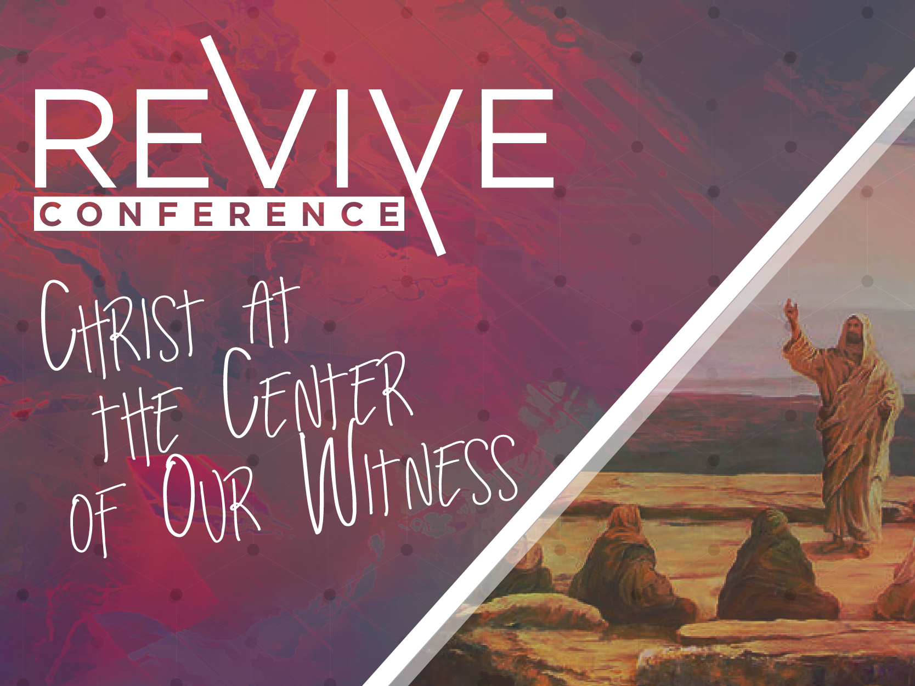

Slide 2
Defining Terms
Pre-Commitments- Foundational beliefs that you judge everything through
Worldview- A network of beliefs
Repentance- Changing your mind
Autonomy- Being a law unto yourself

Slide 3
Verses 13-14
Keeping Christ central in our witnessing brings suffering for good

Slide 4
Verses 15
Keeping Christ central in our witnessing means neither neglecting the worship of Christ nor deny His Lordship

Slide 5
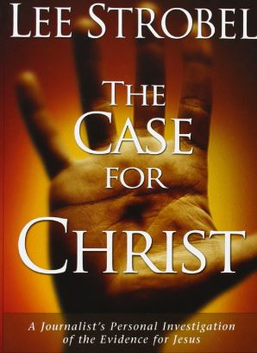
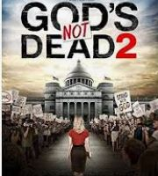
These movies and books do not give man what he needs

Slide 6
What is the heart of the matter?

Slide 7
Verses 15
Keeping Christ central in our witnessing, allows for a defense of what we believe- in such a way- that it grows our worship and deepens His Lordship

Slide 8
What do we defend?

Slide 9
R.U.L.I.N.G.
Revealed Knowledge
Uniformity in Nature
Life is intelligible
Impossible of Contrary
Neutrality is a lie
God’s Laws

Slide 10
Cornelius Van Til- The only proof for the existence of God is that without God you can’t prove anything

Slide 11
Jesus -"An evil and adulterous generation seeks after a sign; and a sign will not be given it, except the sign of Jonah.“ Matt 16:4

Slide 12
Who are we suppose to share with?

Slide 13
How do we defend?

Slide 14
Why do we defend?

